Slide 1
Static Files
CSS files, Javascript Files, image files, video files etc are considered as static files in Django.
Django provides django.contrib.staticfiles to help you manage them.
django.contrib.staticfiles collects static files from each of your applications (and any other places you specify) into a single location that can easily be served in production.

Slide 2
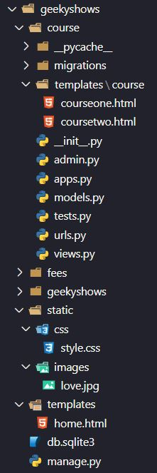
How to Create Static Folder and Files
We create static folder inside Root Project Folder then inside static folder we create required folders which will contain all static files respectively like css folder will contain all css files, image folder will contain all images and so on.
geekyshows
static
css
style.css
custom.css
images
love.jpg
pic1.jpg
templates
geekyshows
manage.py
course

Slide 3
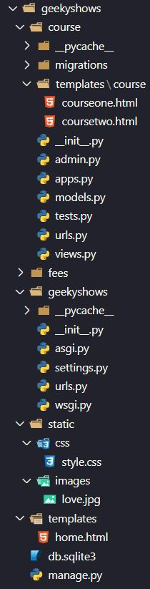
Add Static in settings.py
settings.py
TEMPLATES_DIR = BASE_DIR / ‘templates’
STATIC_DIR = BASE_DIR / ‘static’
INSTALLED_APPS = [
‘course’
]
TEMPLATES = [
{
‘DIRS’: [TEMPLATES_DIR]
}
]
STATIC_URL = ‘/static/’
STATICFILES_DIRS = [ STATIC_DIR ]
Old Django Version 3.0
TEMPLATES_DIR = os.path.join(BASE_DIR, ‘templates’)
STATIC_DIR = os.path.join(BASE_DIR, ‘static’)
Django Version 3.1

Slide 4
Use Static Files in Template Files
First Load Static Files
Reference Static Files
templates/course
courseone.html
<!DOCTYPE html>
{% load static %} // Loading Static Files
<html>
<link href=‘{% static “css/style.css” %}’>
<body>
<h1>Fees {{fe}} </h1>
<img src=‘{% static “images/love.jpg” %}’>
</body>
</html>
Referencing static files

Slide 5
load Template Tag
{% load module_name %} – It loads a custom template tag set.
Example:- {% load emotags %}
Example:- {% load geek.mytags %}
Example:- {% load emotags geek.mytags %}
Template would load all the tags and filters registered in emotags and mytags located in package geek.
You can also selectively load individual filters or tags from a library or module, using the from argument. Example - {% load cry lol from emotags %}
The template tags/filters named cry and lol will be loaded from emotags.

Slide 6
static Template Tag
{% static filename %} – This tag is used to link to static files that are saved in STATIC_ROOT. If the django.contrib.staticfiles app is installed, the tag will serve files using url() method of the storage specified by STATICFILES_STORAGE.
Syntax:-
{% load static %}
{% static filename %}
{% static path/filename %}
{% static path/filename as variable %}
Example:-
<link rel="stylesheet" href="{% static ‘style.css’ %}" >
<link rel="stylesheet" href="{% static ‘css/style.css’ %}" >
<img src="{% static ‘images/love.jpg’ %}">
{% static "images/love.jpg" as mylove %}
<img src="{{ mylove }}">

Slide 7
get_static_prefix Template Tag
{% get_static_prefix %} - We should prefer the static template tag, but if you need more control over exactly where and how STATIC_URL is injected into the template, you can use the get_static_prefix template tag.
Example:-
{% load static %}
<img src="{% get_static_prefix %}images/love.jpg“ >
There’s also a second form you can use to avoid extra processing if you need the value multiple times.
{% load static %}
{% get_static_prefix as STATIC_PREFIX %}
<img src="{{ STATIC_PREFIX }}images/love.jpg">
<img src="{{ STATIC_PREFIX }}images/pic1.jpg">

Slide 8
STATIC_URL – This is the URL to use when referring to static file located in STATIC_ROOT. It must end in a slash if set to a non-empty value.
Example:- “/static/”
Example:- “http://static.example.com/”
STATIC_ROOT – This is absolute path to the directory where collectstatic will collect static files for deployment. It is by default None.
Example:- “/var/www/example.com/static/”
Example:- os.path.join(BASE_DIR, ‘static/')
STATICFILES_DIRS - This setting defines the additional locations the staticfiles app will traverse if the FileSystemFinder finder is enabled, e.g. if you use the collectstatic or findstatic management command or use the static file serving view. It is by default an empty list.
STATICFILES_DIRS = [
"/home/special.geek.com/geek/static",
"/home/geek.com/geek/static",
"/opt/webfiles/common",
]

Slide 9
STATICFILES_STORAGE - The file storage engine to use when collecting static files with the collectstatic management command.
Default: 'django.contrib.staticfiles.storage.StaticFilesStorage'
A ready-to-use instance of the storage backend defined in this setting can be found at django.contrib.staticfiles.storage.staticfiles_storage

Slide 10
Geeky Steps
Create Django Project: django-admin startproject geekyshows
Create Django Application1: python manage.py startapp course
Create Django Application2: python manage.py startapp fees
Add/Install Applications to Django Project (course and fees to geekyshows) using settings.py INSTALLED_APPS
Create templates folder inside each application and inside Root Project Folder
Check ‘APP_DIRS’ : True in settings.py
Add templates directory which is inside Root Project Folder, in settings.py
Create folder inside app/templates directory for template files
Create template files inside app/templates/folder
Create template files inside templates folder which is inside Root Project Folder
Create static folder inside Root Project Folder
Create css, js, images, video etc folder inside static folder
Create static files inside css, js, images, video etc folder.
Write View Function inside views.py file
Define url for view function of application using urls.py file
Write Template files code
Write Static file code

Slide 11
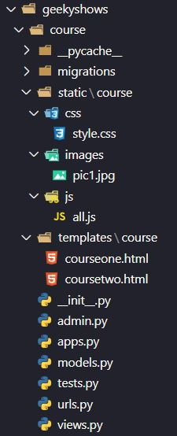
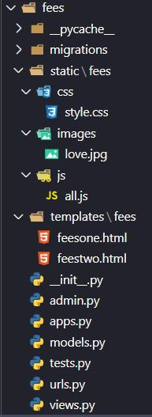
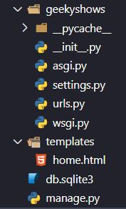
How to Create Static Folder and Files inside Application
We create static folder inside Application Folder then inside static folder we create required folders which will contain all static files respectively like css folder will contain all css files, image folder will contain all images and so on.

Slide 12
Add Static in settings.py
settings.py
TEMPLATES_DIR = BASE_DIR / ‘templates’
STATIC_DIR = BASE_DIR / ‘static’
INSTALLED_APPS = [
‘course’
]
TEMPLATES = [
{
‘DIRS’: [TEMPLATES_DIR]
}
]
STATIC_URL = ‘/static/’
STATICFILES_DIRS = [ STATIC_DIR ]
Old Django Version 3.0
TEMPLATES_DIR = os.path.join(BASE_DIR, ‘templates’)
STATIC_DIR = os.path.join(BASE_DIR, ‘static’)
Django Version 3.1

Slide 13
Use Static Files in Template Files
First Load Static Files
Reference Static Files
templates/course
courseone.html
<!DOCTYPE html>
{%load static %} // Loading Static Files
<html>
<link href=‘{%static “course/css/style.css”}’>
<body>
<h1>Fees {{fe}} </h1>
<img src=‘{%static “course/images/pic1.jpg”}’>
</body>
</html>
Referencing static files

Slide 14
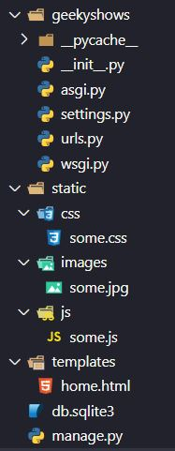
How to Create Static Folder and Files inside Project & Application

Slide 15
Add Static in settings.py
settings.py
TEMPLATES_DIR = BASE_DIR / ‘templates’
STATIC_DIR = BASE_DIR / ‘static’
INSTALLED_APPS = [
‘course’
]
TEMPLATES = [
{
‘DIRS’: [TEMPLATES_DIR]
}
]
STATIC_URL = ‘/static/’
STATICFILES_DIRS = [ STATIC_DIR ]
Old Django Version 3.0
TEMPLATES_DIR = os.path.join(BASE_DIR, ‘templates’)
STATIC_DIR = os.path.join(BASE_DIR, ‘static’)
Django Version 3.1

Slide 16
Use Static Files in Template Files
First Load Static Files
Reference Static Files
<!DOCTYPE html>
{%load static %} // Loading Static Files
<html>
<link href=‘{%static “css/some.css”}’>
<body>
<h1>Fees {{fe}} </h1>
<img src=‘{%static “course/images/pic1.jpg”}’>
</body>
</html>

Slide 17
static Template Tag
get_media_prefix - Similar to the get_static_prefix, get_media_prefix populates a template variable with the media prefix MEDIA_URL, e.g.:
{% load static %}
<body data-media-url="{% get_media_prefix %}">
By storing the value in a data attribute, we ensure it’s escaped appropriately if we want to use it in a JavaScript context.

